Slide 1
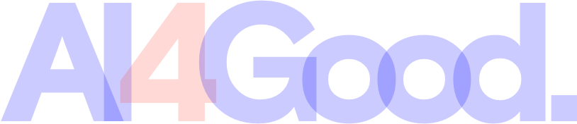
Braille to Text Converter
AEyeAlliance
Helen, Wan-Chun, Ting-Yi, Marin

Slide 2
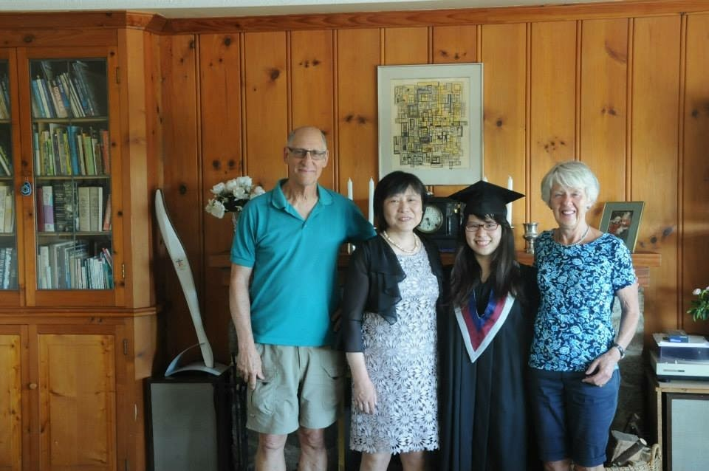
Why Braille?

Slide 3
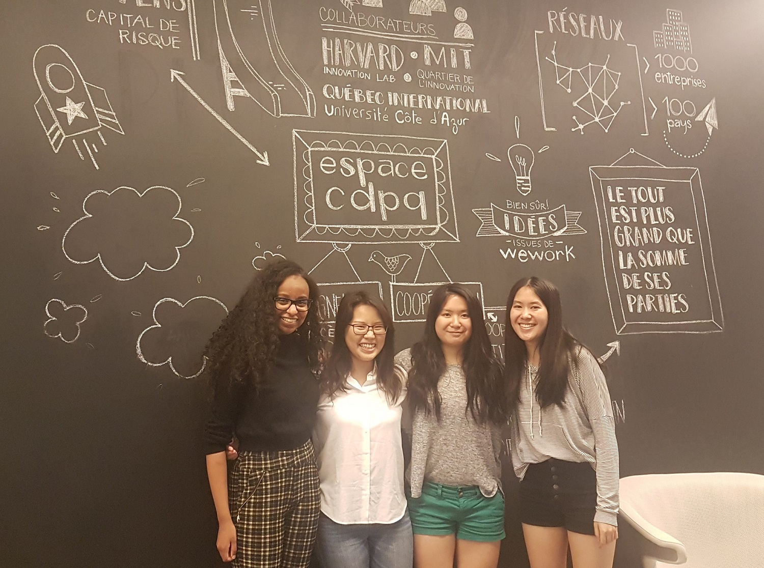
Our Vision
Notes:
Bridge the gap of communication between non-blind and blind people
Raise awareness of Braille

Slide 4
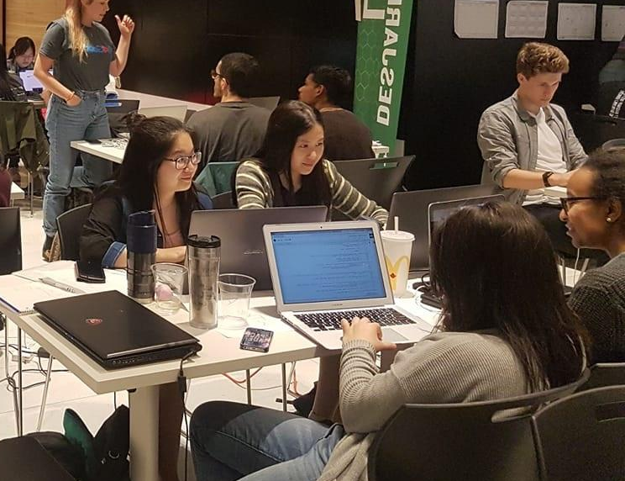
During the hackathon...

Slide 5
Our Goals
Back-End Wise
Our own dataset
Model that recognizes Braille characters
Character to word recognition
Front-End Wise
Web application
Android app

Slide 6
Our Dataset & Model
37 characters (26 letters in the alphabet and 11 symbols)
Convolutional Neural Network

Slide 7
26,724
99.333%
Cropped images in our dataset!!
Accuracy!

Slide 8
Characters
Words
We are here!
Space recognition now allows us to translate a line!!
Lines
Paragraphs

Slide 9
Line Recognition

Slide 10
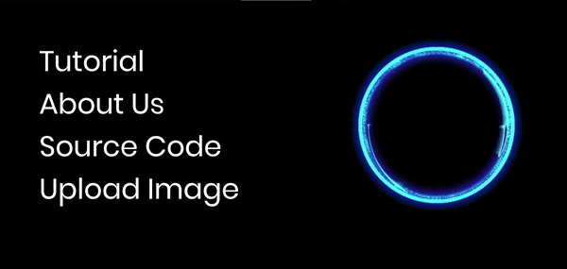
Our Website
Place your screenshot here

Slide 11
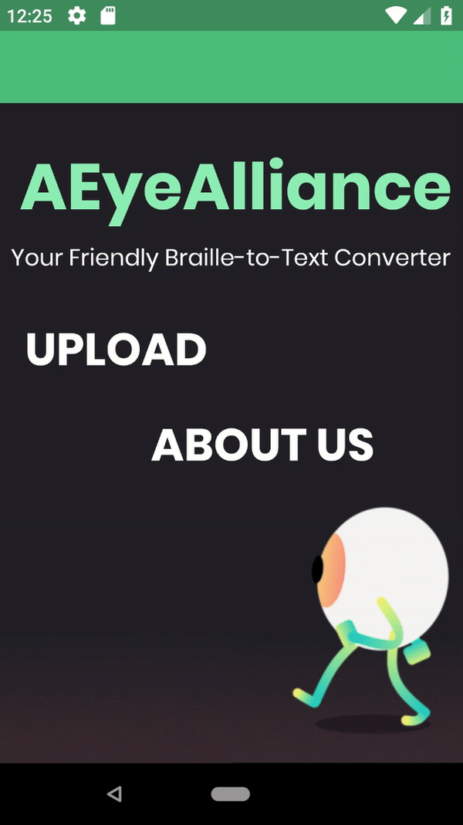
Our Android App

Slide 12
Our Future Goals
Try out image segmentation
Auto detect different Braille languages
Expand and open-source our dataset
Debug errors from linking model to android app

Slide 13
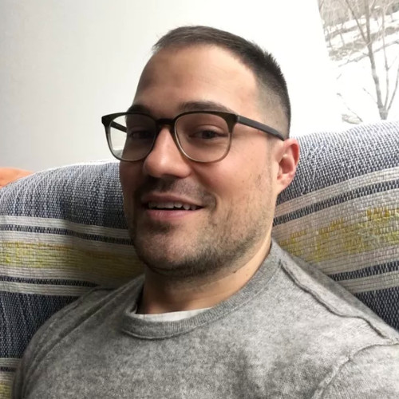
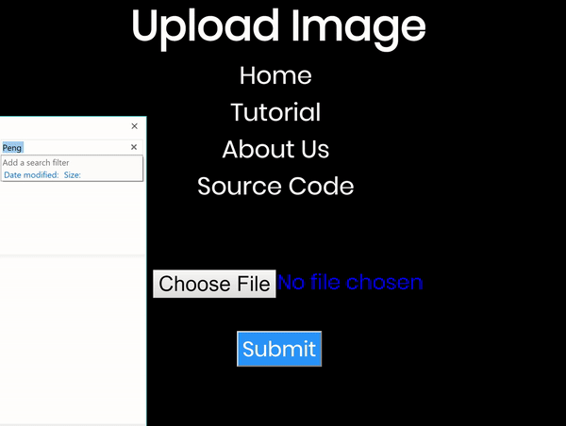
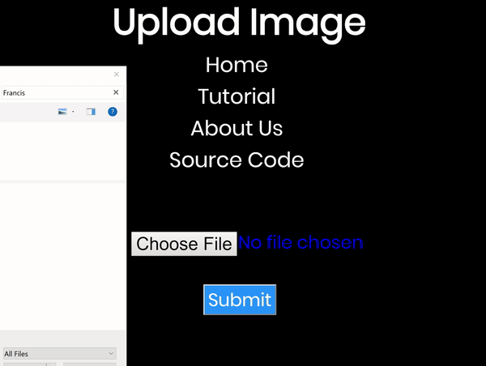
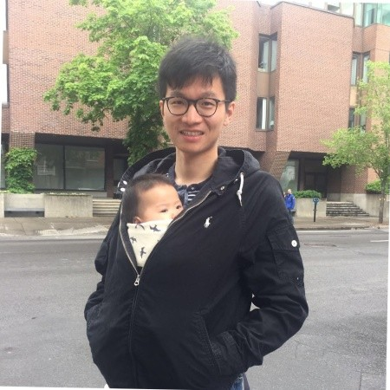
Special thanks to our mentors Peng Yu and Francis Gregoire!

